Slide 1

Title Slide
Assessing Your Board Needs
Natasha Davis
Natasha Davis | Program Coordinator
International & Public Affairs | UNCW
T: 910-962-2878 | davisn@uncw.edu
www.uncw.edu/qeno

Slide 2

Board Revitalization
Identify
Rotate
Cultivate
Evaluate
Recruit
Educate
Orient
Involve
Notes:
Where did we get this?

Slide 3
Responsible Boards
Avoid keeping ineffective structures & practices simply because “it has always been done that way!”
Engage in intentional practices that
  Promote effectiveness and efficiency;
  Focus on strategic goals of the organization.

Slide 4
Identify – Board Matrix
Identify board needs (skills, knowledge, perspective, connections) needed to accomplish the long term goals of the organization.
Identify gaps between board resources and board needs.
Identify candidates who could fill the identified gaps.
Notes:
How to use the two handouts.

Slide 5
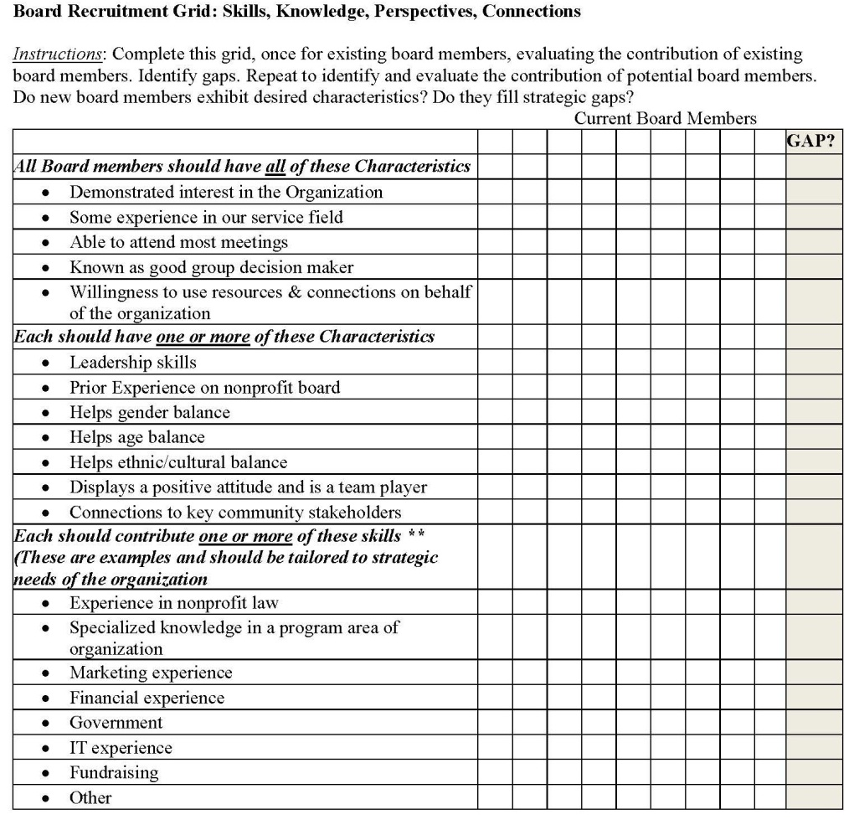


Slide 6
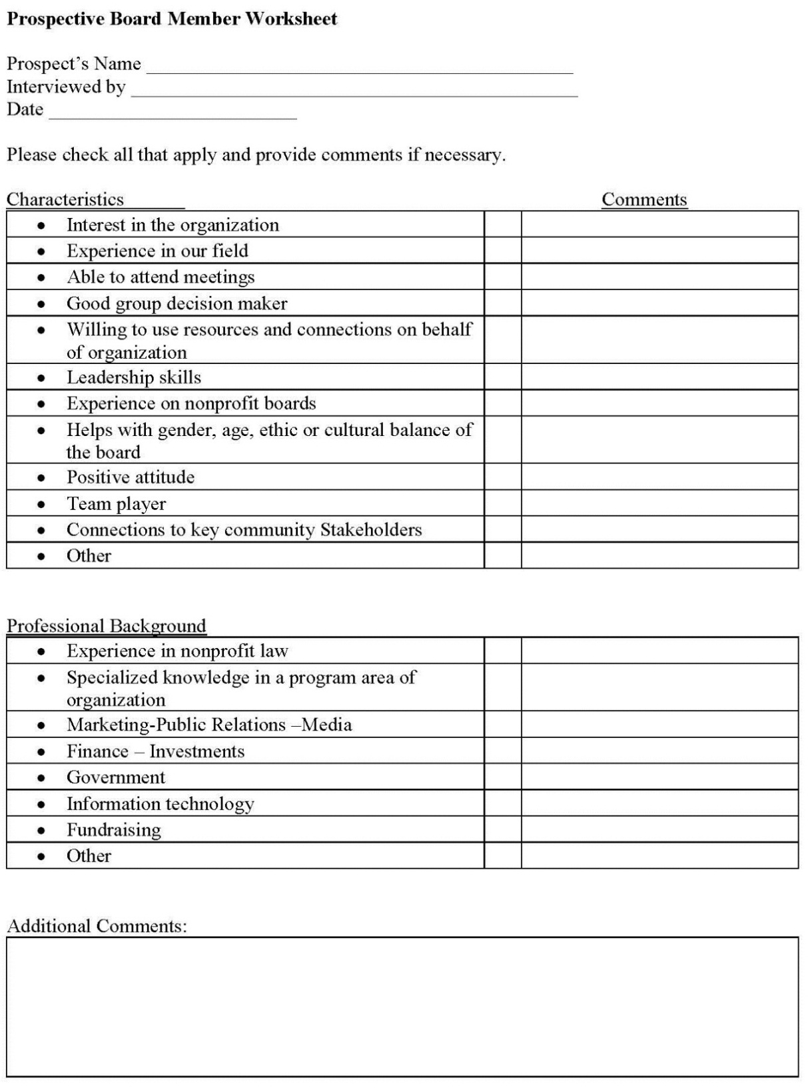


Slide 7
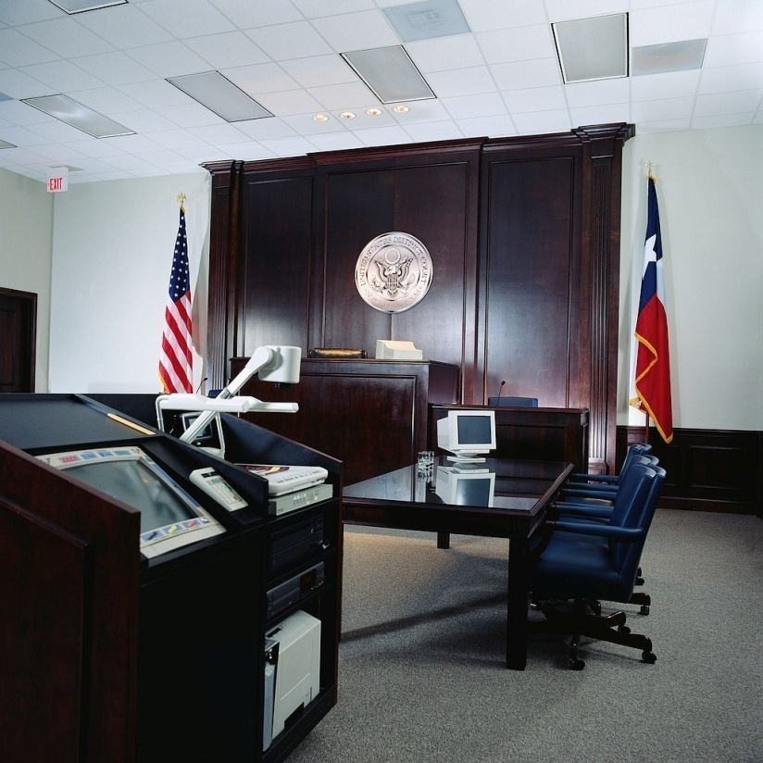
Duty of Care – Must Know
Pay attention!
  Attend all meetings;
  Review financial statements;
  Read and approve the minutes
  and other information prior to
  meetings;
  Ask questions.

Slide 8

Duty of Loyalty – Putting the Organization First
  Make decisions with organization’s best interest in mind.
  Avoid conflicts of interests.
    Know and report any potential
    conflicts.
  Maintain confidentiality of
  organizational matters

Notes:
Activity: Conflict of interest policy examples when breaching contract?

Slide 9
Duty of Obedience –
“follow the law”
Review Articles of Incorporation and organizational By-laws
Ensure that individual & organizational decision making follow By-laws and Articles of Incorporation
Ensure that organization actions are in compliance with the laws of the land.

Slide 10
The Board’s Role in Fundraising
Define Mission, plan for future
Partnership with CEO
Strategic Thinking –monitor progress
Put process in place
Ensure adequate resources for success
Participate
Engage
Reach out to your Circle of Influence
Ask
Inspire
Notes:
Do NOT let this get out of control. AFP can do a much better job than we can on fundraising practices, so we can send participants to them for detailed information. The next slide allows them to brainstorm some ideas, but again..we cannot let this consume the time. Our job at QENO is to teach them what to do with the money they get…how to be responsible.

Slide 11
Action Plan
Goal | Strategy | Task/Action Plan | Responsible Party | Timeline | Evaluation
Long term outcome of your project | How will you reach the goal? | Specific steps needed to accomplish the strategy | What committee or person is responsible for accomplishing the task? | When should it be completed? | How will success be identified?

Slide 12
Orientation
Orientation should result in new members having a sense of:
  Organization’s mission, vision, & programs
  Strategic Plan
  Organization’s financial situation
  Major initiatives that are currently underway
  Structure of the board & staff
  Roles & responsibilities as board members
Notes:
What happens at your orientation for new board members? What would you like to have happen?

Slide 13
www.uncw.edu/QENO www.facebook.com/QENO1
Nonprofit Workshops
AmeriCorp VISTA Program
Executive Director Roundtables
Lunch & Learn Series
Weekly Newsletter
Consulting/ Coaching
QENO
Student Applied Learning Projects
Natasha Davis, MPA
Program Coordinator
UNCW Dept. of Public & International Affairs
Social & Behavioral Sciences Bldg, Office 110 H
davisn@uncw.edu
910-962-2878
Dr. Jeffrey Brudney, PhD
Academic Director
and
Betty & Dan Cameron Family Distinguished Professor for Innovation in the Nonprofit Sector
UNCW Dept. of Public & International Affairs

